Slide 1
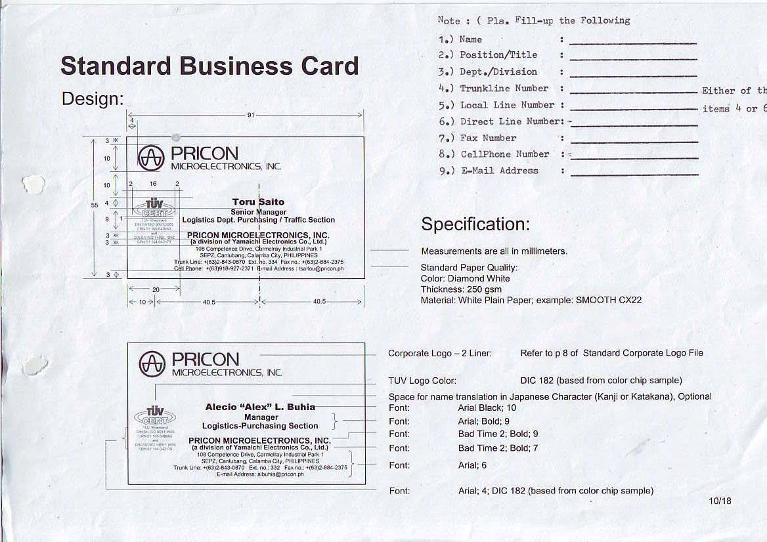
Kevin Jan Erasquin
Sr. Engineer
TS Section
+(63) 2-843-0870
234 / 135
--
+(63) 2-843-0870 Loc. 300-301
+(63) 0995-459-7038
kjterasquin@pricon.ph

